Slide 1
PIC simulations of magnetic reconnection

Slide 2
Cerutti et al. 2013
3D PIC simulations of relativistic pair plasma reconnection (Zeltron code)
Includes
  Radiation reaction force (Lorentz-Abraham-Dirac equation)
  Guide field
Results:
Tearing instability and fast reconnection (xy-plane): 70% of the magnetic energy dissipated in particle acceleration.
Kink instability of the current sheet (yz-plane): 55% of the total magnetic energy is dissipated.
Relativistic kink instability disrupt the layer (see also, e.g., Zenitani & Hoshino 2008, Sironi & Spitkovsky 2011).
A moderate guide field stabilizes the layer and enable particle acceleration

Slide 3
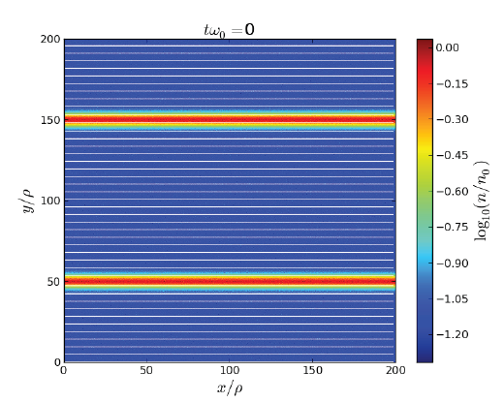
Tearing instability

Slide 4
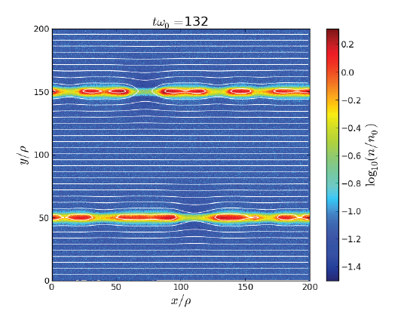
Tearing instability

Slide 5
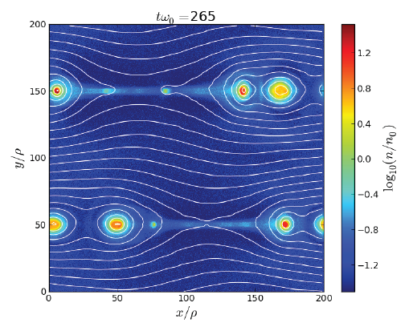
Tearing instability

Slide 6
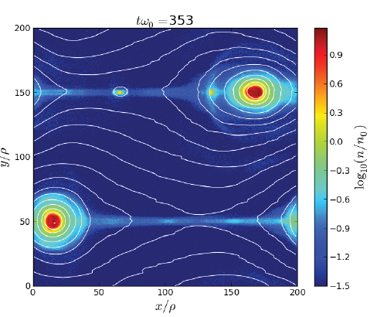
Tearing instability

Slide 7
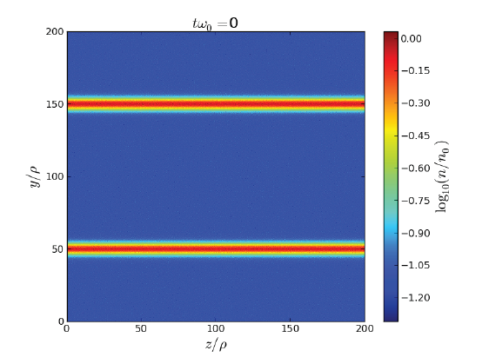
Kink instability of the current sheet

Slide 8
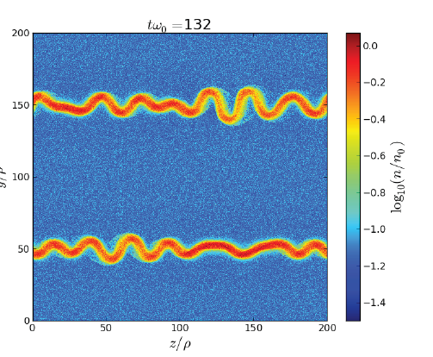
Kink instability of the current sheet

Slide 9
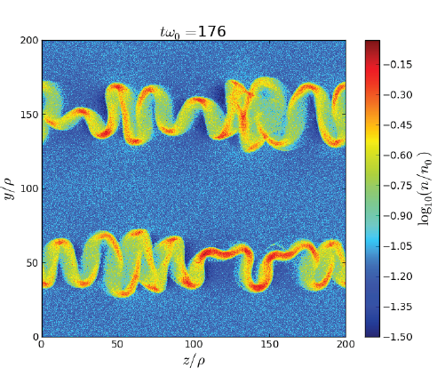
Kink instability of the current sheet

Slide 10
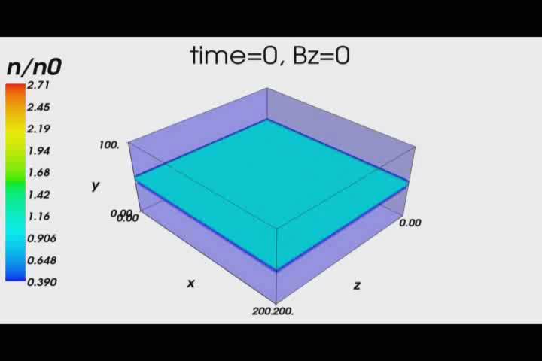

Slide 11
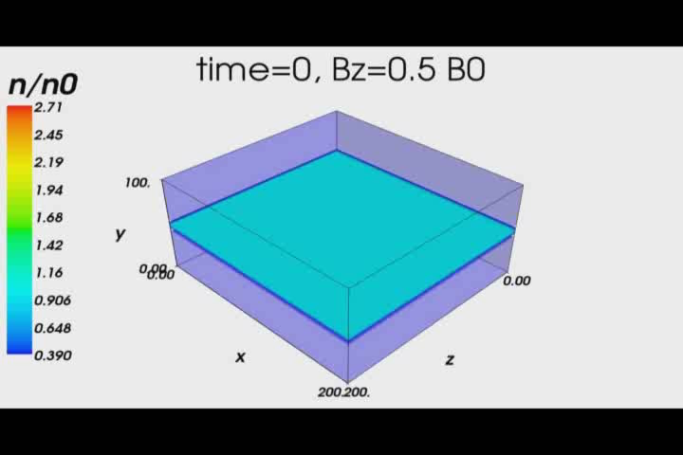

Slide 12
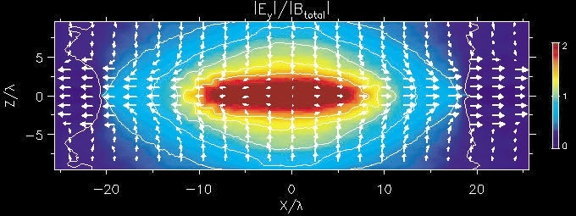
Ratio of the inductive electric field |E_{Y}| to the magnetic field |B_{total}| = (B_{X}²+B_{Z}²)^{1/2}
Particle acceleration in reconnection takes place mainly around the X-type neutral region, where the amplitudes of magnetic fields are weak and charged particles become unmagnetized. They are accelerated by an inductive electric field perpendicular to the two-dimensional reconnection magnetic fields (Zenitani & Hoshino 2001).

Slide 13
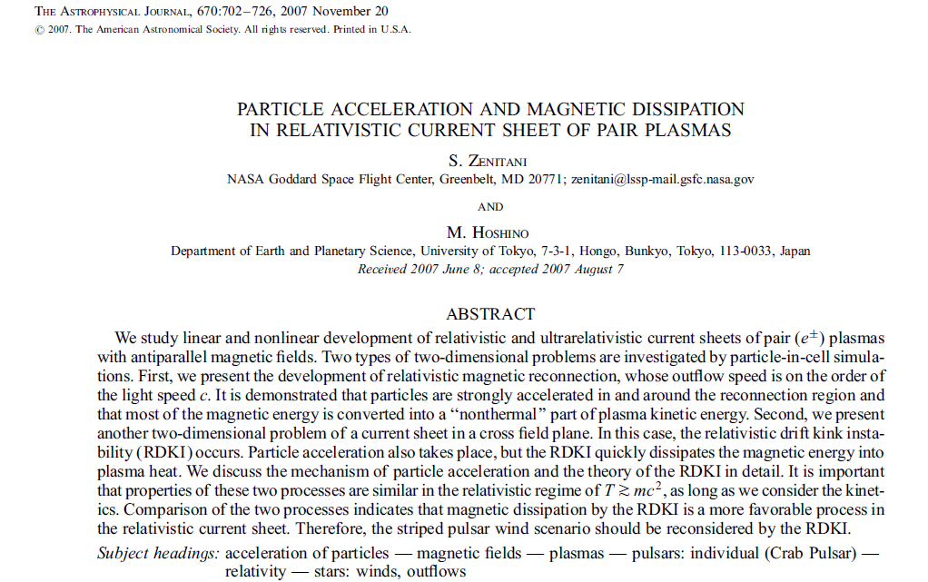

Slide 14
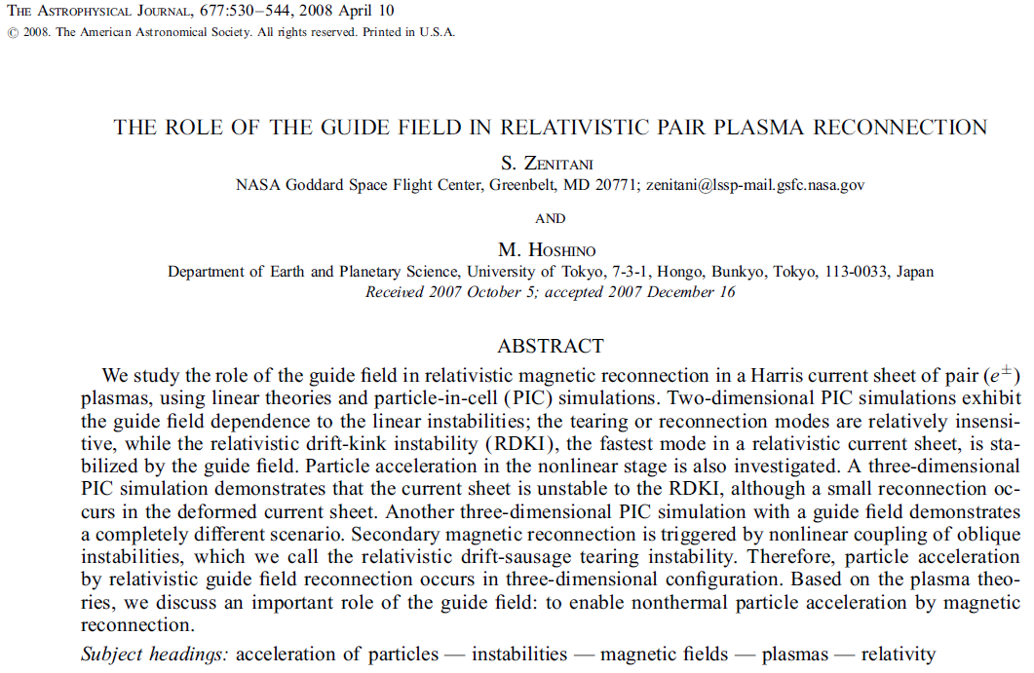

Slide 15
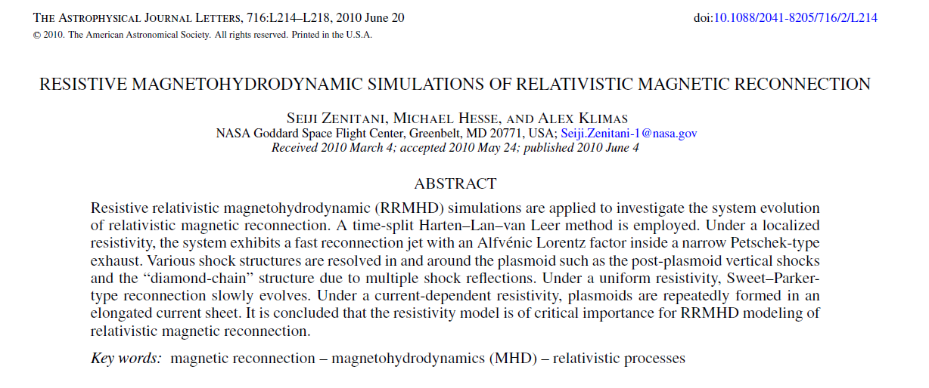

Slide 16
Baty, Petri, Zenitani 2013
Resistive relativistic 2D MHD simulations
Fast reconnection during double tearing modes in relativistic plasma
Time scale of instability weakly depending on the Lundquist number

